Slide 1
Speech Contests 101
Presenter
Atiana Beck, DL3

Slide 2
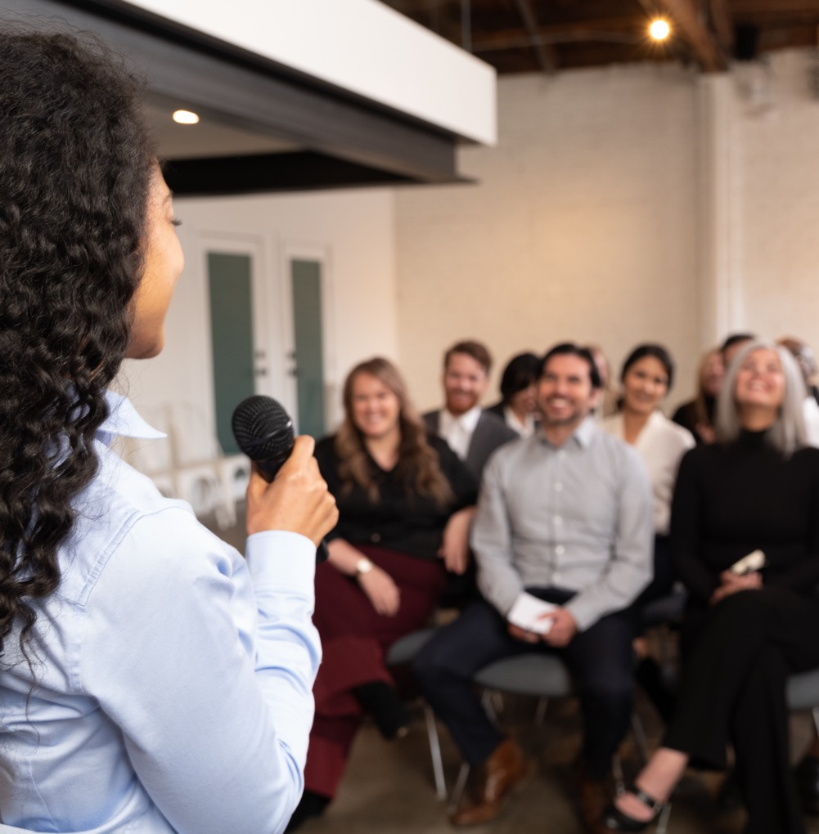
History of Speech Contests
-Ralph C. Smedley started Toastmasters. First meeting March 24,1905 (Toastmasters International).
-The World Championship of Public Speaking began in 1938 and has grown to over 30,000 participants in 141 countries (Wikipedia).

Slide 3
Toastmasters International Speech Contest Types
Contest Type | Year Held
International | Every Year
Evaluation | 2018 | 2023 | 2027 | 2031
Humorous | 2020 | 2024 | 2028 | 2032
Table Topics | 2021 | 2025 | 2029 | 2033
Tall Tales | 2022 | 2026 | 2030 | 2034
International
Evaluation
Humorous
Table Topics™
Tall Tales

Slide 4
Purpose of Speech Contests
Participants gain speaking experience.
Recognize individual Toastmasters as an encouragement to all.
Toastmasters can observe speakers who have benefited from their Toastmasters training.
Opportunity to learn about a specific area of communication.

Slide 5

Why Compete in a Speech Contest?

Slide 6
Reasons to Compete in Speech Contests
Vision: First interaction with other Toastmasters from different clubs with different club cultures.
Confidence: Speaking in front of strangers boosts confidence.
Determination: If at first you don’t succeed try and try again.
Network: Chance to meet others from all over and gain new ideas.
Inspiration: Excellent motivator on ways to improve your technique.

Slide 7
Club Level Speech Contests
Review the Speech Guide and Speech Planning document.
Start Planning and promoting club contest several months in advance.
Recommended to hold club contests at the same time every year so members can plan.
Club contest should be held in February (recommended 2 weeks prior to the Area contest)
Contest Chair
*At least 5 voting judges
A tiebreaking judge
*3 Counters
*2 Timers
*Unless impractical
Planning and Preparation
Time Frame
Roles

Slide 8
Eligibility Requirements
International Speech Contest member must have completed six speech projects in Competent Communication manual or completed levels 1 and 2 of any paths in Pathways.
Member should be in good standing of club (dues current).
If member belongs to more than one club, they may only represent one club in the Area level contest.
District Officers may not compete in any contest.

Slide 9
Eligibility Requirements for Judges
Must be a Toastmaster in good standing.
Completed 6 competent communicator manual projects and been a Toastmaster since July 1st of the previous year.
District level judges may not be from the same club as the contestant competing.

Slide 10
Winner Winner Chicken Dinner
Usually held in March or 2 weeks before the Division Contest.
Usually held in April or 2 weeks before the District Conference.
International Speeches are Video Recorded.
Contest is held at the District Conference
Area Contest
Division Contest
District Contest

Slide 11
Winner Winner Chicken Dinner
International Speech is the only one eligible to compete.
Speeches are video recorded at the District contest and submitted to World Headquarters.
Top two winners from each Regional Quarterfinal contest.
Held at the International Convention.
Present new speech than one presented during that year’s semifinal contest.
You are the best, of the best, of the best!
Region Quarterfinals
Semi Finals
World Championship

Slide 12
Conducting Online Speech Contests
479 Online Speech Contest Best Practices (azureedge.net) This is a resource used to conduct online speech contests
Choose a format. Zoom or a similar platform, you may have the choice to organize your contest as either a meeting or a webinar
Zoom Breakout Rooms – 13min video *starts at the 2 minute mark How to use Zoom Breakout Rooms - Tutorial for Beginners - YouTube
May need to use private chat or outside chat method for judges and ballot judging.
Speech contest kit forms are available for download and are fillable. Speech Contests - Toastmasters District 78 (d78toastmasters.org)

Slide 13
Resources
Speech Contest Planning Guide PDF-Michele Blumhagen
Toastmasters International -Online Meetings
District 78 Website- Speech Contests - Toastmasters District 78 (d78toastmasters.org)
Speech Contest Rulebook PDF 1171 Speech Contest Rulebook (azureedge.net) Toastmasters International search under resources
Area Director-Division Director-District Program Quality Director
World Headquarters: Email: speechcontests@toastmasters.org Phone: 949-858-8255

Slide 14
Recap
Successful speech contests are all about preparing.
Have a good speech contest chair.
Make checklists.
Give timeline and deadlines.
Utilize the Toastmaster directors.

Slide 15

QUESTIONS???????????

Slide 16
References
World Championship of Public Speaking - Wikipedia retrieved 2/3/2021
Toastmasters International –History retrieved 2/3/2021
Speech Contests - Toastmasters District 78 (d78toastmasters.org) Retrieved 2/4/2021
Blumhagen, Michele -Speech Contest Planning Guide- June 2008-2017 PDF
https://www.toastmasters.org/

